Slide 1

YSC2239 Lecture 10

Slide 2
Recap
A/B testing
Confidence Intervals
Significant level (also called alpha level)
Python command
Percentile

Slide 3
Today’s class
Central and Spread
Central limit theorem
Correlation
Reading: Chapter 14, 15

Slide 4
Confidence Intervals For Testing

Slide 5
Using a CI for Testing
What if we want to do a hypothesis test, but we can’t simulate under the null?
Null hypothesis: Population average = x
Alternative hypothesis: Population average ≠ x
Cutoff for P-value: p%
Method:
Construct a (100-p)% confidence interval for the population average
If x is not in the interval, reject the null
If x is in the interval, can’t reject the null

Slide 6
Center and Spread

Slide 7
Questions
How can we quantify natural concepts like “center” and “variability”?
Why do many of the empirical distributions that we generate come out bell shaped?
How is sample size related to the accuracy of an estimate?

Slide 8
Average

Slide 9
The Average (or Mean)
Data: 2, 3, 3, 9 Average = (2+3+3+9)/4 = 4.25
Need not be a value in the collection
Need not be an integer even if the data are integers
Somewhere between min and max, but not necessarily halfway in between
Same units as the data
Smoothing operator: collect all the contributions in one big pot, then split evenly
(Demo)

Slide 10
Comparing Mean and Median
Mean: Balance point of the histogram
Median: Half-way point of data; half the area of histogram is on either side of median
If the distribution is symmetric about a value, then that value is both the average and the median.
If the histogram is skewed, then the mean is pulled away from the median in the direction of the tail.

Slide 11
Standard Deviation

Slide 12
Defining Variability
Plan A: “biggest value - smallest value”
Doesn’t tell us much about the shape of the distribution
Plan B:
Measure variability around the mean
Need to figure out a way to quantify this
(Demo)

Slide 13
How Far from the Average?
Standard deviation (SD) measures roughly how far the data are from their average
SD = root mean square of deviations from average
SD has the same units as the data

Slide 14
Why Use the SD?
There are two main reasons.
The first reason:
No matter what the shape of the distribution,
the bulk of the data are in the range “average ± a few SDs”
The second reason:
Coming up in the next lecture.

Slide 15
Standard Units

Slide 16
Standard Units
How many SDs above average?
z = (value - average)/SD
Negative z: value below average
Positive z: value above average
z = 0: value equal to average
When values are in standard units: average = 0, SD = 1
Chebyshev: At least 96% of the values of z are between -5 and 5 ( i.e.: average – 5*SD , average + 5*SD)
(Demo)

Slide 17
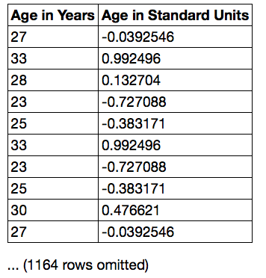
Discussion Question
Find whole numbers that are close to:
the average age
the SD of the ages
(Demo)

Slide 18
The SD and the Histogram
Usually, it's not easy to estimate the SD by looking at a histogram.
But if the histogram has a bell shape, then you can.

Slide 19
The SD and Bell-Shaped Curves
If a histogram is bell-shaped, then
the average is at the center
the SD is the distance between the average and the points of inflection on either side
(Demo)

Slide 20
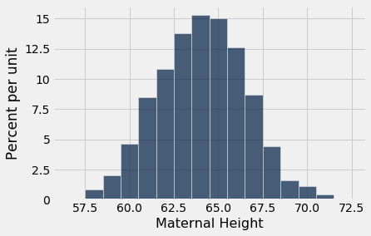
Point of Inflection

Slide 21
The Normal Distribution

Slide 22
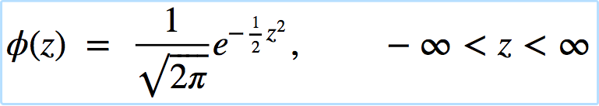
The Standard Normal Curve
A beautiful formula that we won’t use at all:

Slide 23
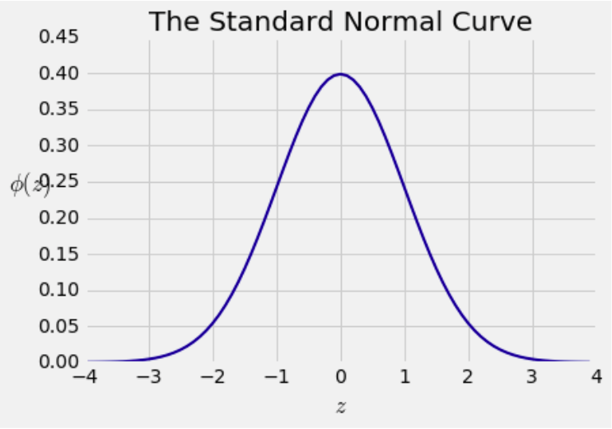
Bell Curve

Slide 24
Normal Proportions

Slide 25
How Big are Most of the Values?
No matter what the shape of the distribution,
the bulk of the data are in the range “average ± a few SDs”
If a histogram is bell-shaped, then
Almost all of the data are in the range
“average ± 3 SDs”

Slide 26
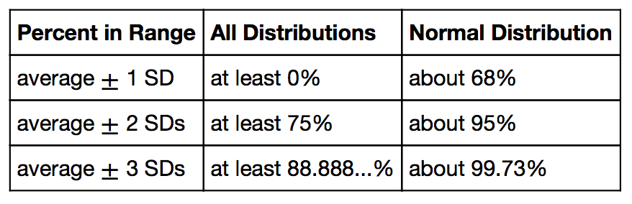
Bounds and Normal Approximations

Slide 27
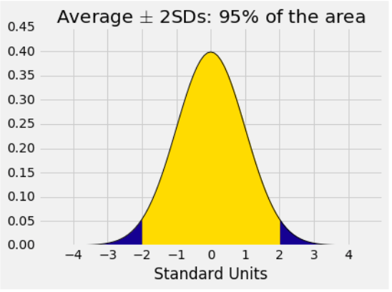
A “Central” Area

Slide 28
Central Limit Theorem

Slide 29
Sample Averages
The Central Limit Theorem describes how the normal distribution (a bell-shaped curve) is connected to random sample averages.
We care about sample averages because they estimate population averages.

Slide 30
Central Limit Theorem
If the sample is
large, and
drawn at random with replacement,
Then, regardless of the distribution of the population,
the probability distribution of the sample sum
(or the sample average) is roughly normal
(Demo)

Slide 31
Distribution of the Sample Average

Slide 32
Why is There a Distribution?
You have only one random sample, and it has only one average.
But the sample could have come out differently.
And then the sample average might have been different.
So there are many possible sample averages.

Slide 33
Distribution of the Sample Average
Imagine all possible random samples of the same size as yours. There are lots of them.
Each of these samples has an average.
The distribution of the sample average is the distribution of the averages of all the possible samples.
(Demo)

Slide 34
Specifying the Distribution
Suppose the random sample is large.
We have seen that the distribution of the sample average is roughly bell shaped.
Important questions remain:
Where is the center of that bell curve?
How wide is that bell curve?

Slide 35
Center of the Distribution

Slide 36
The Population Average
The distribution of the sample average is roughly a bell curve centered at the population average.

Slide 37
Variability of the Sample Average

Slide 38
Why Is This Important?
Along with the center, the spread helps identify exactly which normal curve is the distribution of the sample average.
The variability of the sample average helps us measure how accurate the sample average is as an estimate of the population average.
If we want a specified level of accuracy, understanding the variability of the sample average helps us work out how large our sample has to be.
(Demo)

Slide 39
Variability of the Sample Average
The distribution of all possible sample averages of a given size is called the distribution of the sample average.
We approximate it by an empirical distribution.
By the CLT, it’s roughly normal:
Center = the population average
SD = (population SD) / √sample size
(Demo)

Slide 40
Discussion Question
A city has 500,000 households. The annual incomes of these households have an average of $65,000 and an SD of $45,000. The distribution of the incomes [pick one and explain]:
is roughly normal because the number of households is large.
is not close to normal.
may be close to normal, or not; we can’t tell from the information given.

Slide 41
Correlation Coefficient

Slide 42
Definition of r
Correlation Coefficient (r) =
average of
product of
x in standard units
and
y in standard units
Measures how clustered the scatter is around a straight line

Slide 43
The Correlation Coefficient r
Measures linear association
Based on standard units
-1 ≤ r ≤ 1
r = 1: scatter is perfect straight line sloping up
r = -1: scatter is perfect straight line sloping down
r = 0: No linear association; uncorrelated
(Demo)

Slide 44
Watch Out For ...
Nonlinearity
Outliers
Correlation does not imply causations (https://www.tylervigen.com/spurious-correlations)

Slide 45
To-do
Lab 5
Assignment 5

